Slide 1


MINI PROJECT (2020-21)
MID-TERM REPORT
AUTOMATED CANTEEN ORDERING SYSTEM
SUBMITTED BY :-
HARSHIT BHATIA(181500252)
HIMALAYA SINGH(181500266)
GAGAN SARASWAT(181500231)
MUKUL GOYAL (181500398)
KASHISH CHAUDARY(181500316)
Supervised By :-
Mr. Akash Kumar Choudary(Assistant Professor)

Slide 2
CONTENT
1. Introduction
2. Objectives
3. Modules
4. Progress
5. Some Screenshots
6. Advantages
7. Limitation
8.Application

Slide 3
Introduction
This system is that it greatly simplifies the ordering process for both the customer and the canteen.
The Project “Canteen Automation Ordering System” enables the end users to register online, read and select the food from e-menu card and order food online by just selecting the food that the user want to have using android application. ... This implies that the customer is the regular user of the Canteen.

Slide 4
Objective
The main aim of this project Canteen management system is to provide fast services to their college students, Staffs etc. Usually People have to go to canteen and order the foods and they have to wait in queue for a long time to get the orders. But with the help of this you just have to follow a very simple process to order your stuffs. And you need not to wait in the long queue.

Slide 5
Modules
The system comprises of 3 major modules and their sub modules as follows:
Admin:
Login: Admin need to login using valid login credentials to access the system.
Add Canteen: Admin will add a canteen with details like Management Name, Handler, Mobile, No. of Workers and Address.
View/Edit/Delete Canteen: Added canteens can be manageable by the admin.
Add Students: System allows admin to register new students with their details and create a valid login id and password and share with the student.
View/Edit/Delete Students: Admin can manage all the added students by viewing, editing and deleting a student.
Add Balance: A registered student can Load their wallet by paying cash to admin, which will be added to their wallet account.
Withdraw: Check student's account and withdraw amount) & Same for canteen

Slide 6
.
2. Canteen:
Login: Canteen person need to login using valid login credentials to access the system.
Add Items: A canteen person can add new food items by specifying details like Food name, Items description, cost, time to get ready, etc.
View/Edit/Delete/Enable Items: All the added food items will be manageable by the canteen person and if the item is not available in the canteen then it gives an option to disable the food Item.
View New Orders: Can view all the orders received from the registered students.
Update Status: Can update the order details.
View Transactions: Can view all the transactions by selecting the date range and search all the transactions.
Add Balance: A canteen person can add balance into students wallet, which will be paid via cash by the student.
3. Student:
Login: Students need to login using valid login credentials provided by admin to access the system.
View Menu: Students can order any food item from the menu.
Review & Place Order: Before placing an order, a review of order will be displayed and then student can proceed to pay. If wallet has low balance, then a student cannot make rest of payment via card.
Add Balance: Students can add balance to their wallet via card.
View Transactions: A Student can view all their transactions done to place orders.
Withdraw: Only student can withdraw whenever required.

Slide 7
Progress
Build the first login page using html, css and php:-
. Created the login page.
. Created the different nodes.
. Created the sub nodes and function.

Slide 8
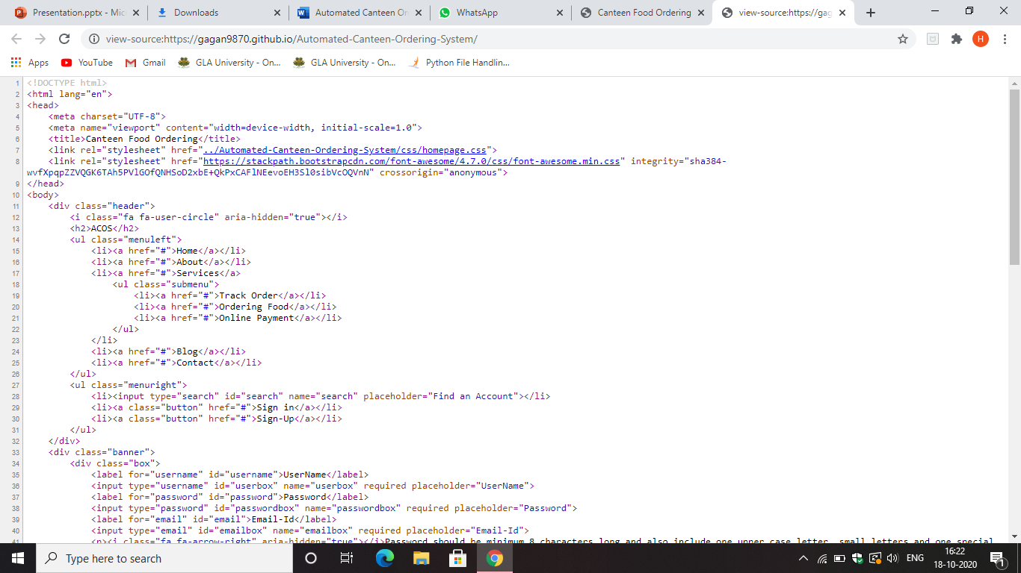
.

Slide 9
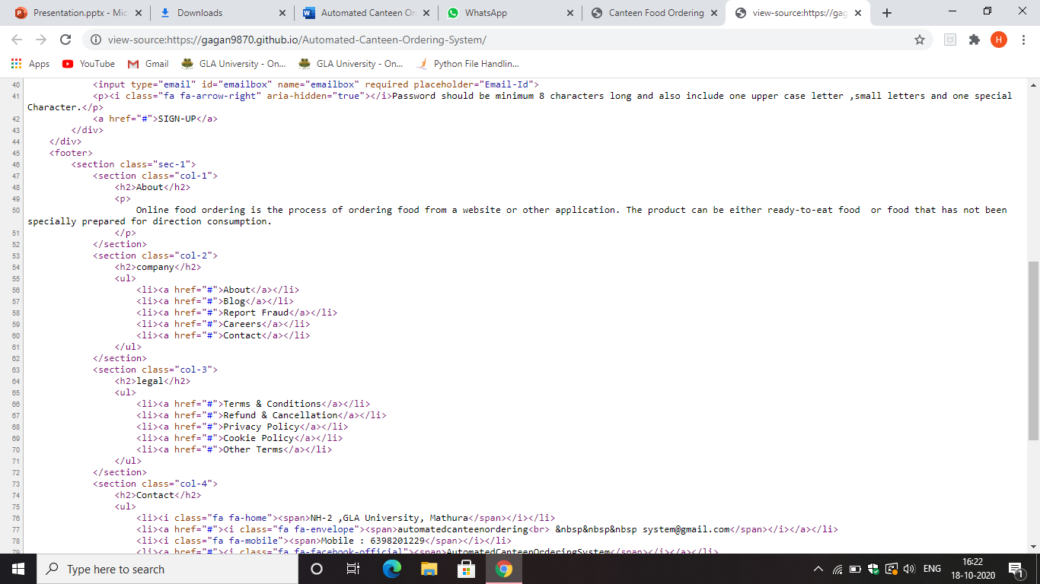
.

Slide 10
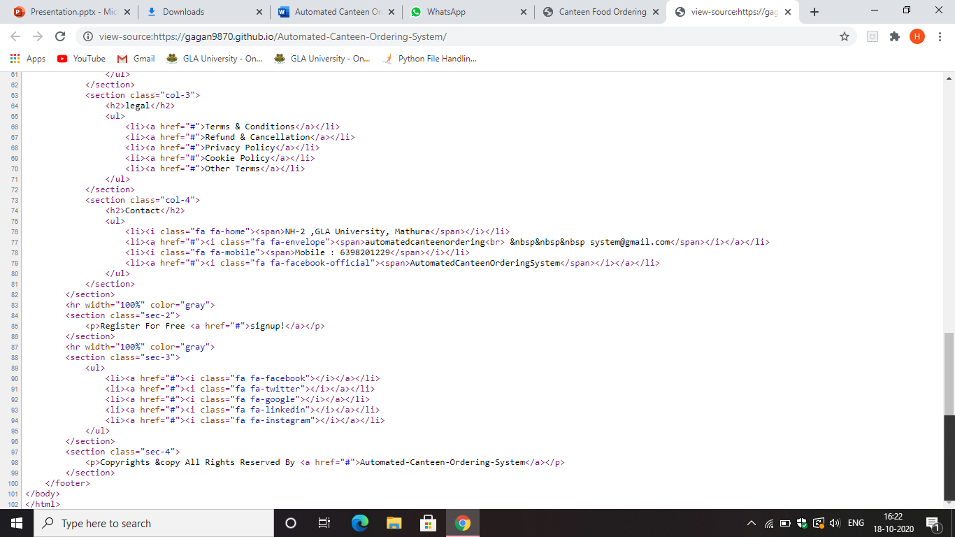
.

Slide 11
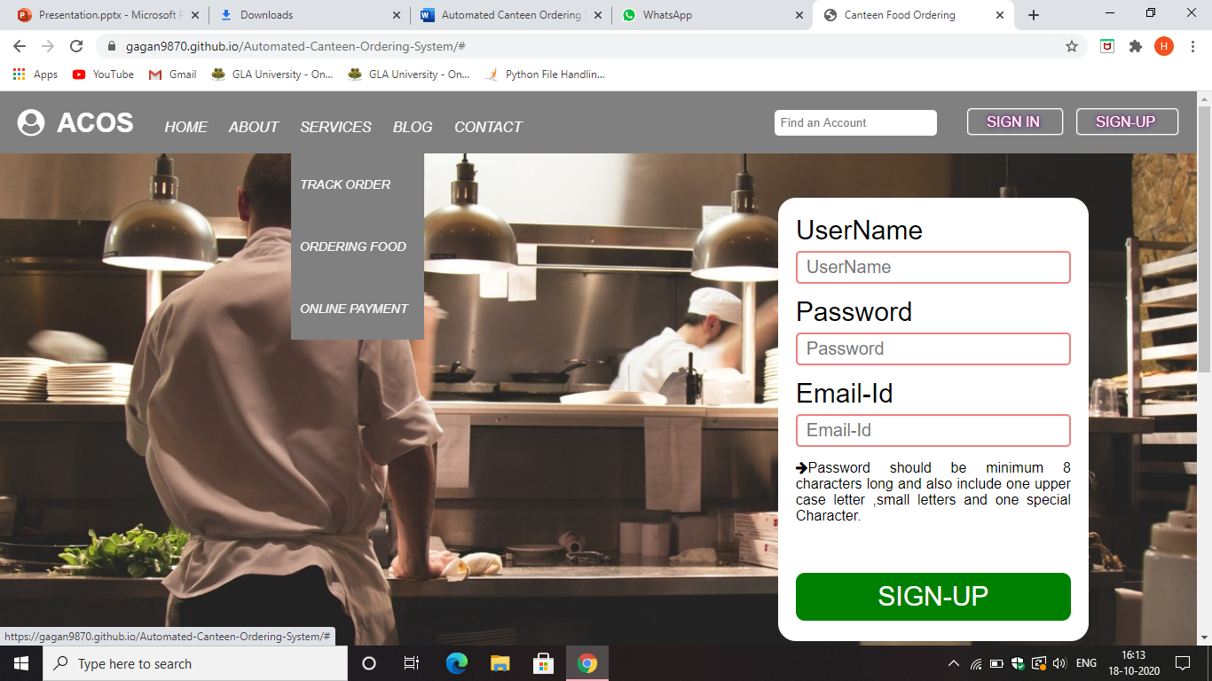
Screenshots :-

Slide 12
Advantages
Completely automated online ordering of food in a canteen.
Order can be placed using personal android phones.
Food ordering pages that look and feel exactly the same as the existing restaurant website.
Single and individual Admin Panel and login for each Canteen
Detailed summary of orders placed with option to search orders, update order status, print orders, etc.

Slide 13
Limitation
Requires an active internet connection.
Requires Android phone if user is ordering.
Application
This system can also be used in Restaurants, Cafeteria, Etc.

Slide 14
References
www.beta-labs.in
Adaptive Web Design By Aaron Gustafson.

